Slide 1

DATA ANALYTICS PORTFOLIO PROJECT
Customer Shopping
Behavior Analysis
End-to-End Data Analytics Project
Python
SQL
Power BI
3,900 Customer Records · 18 Features
Retail Analytics · 2025

Slide 2
TABLE OF CONTENTS
CONTENTS
01
02
03
Project Overview
Data Analysis
Dashboard & Recommendations
Business problem, dataset structure, workflow & data cleaning
SQL business questions, key insights & customer segmentation
Power BI visualization, business recommendations & tech stack
Customer Shopping Behavior Analysis
15 Slides · 2025

Slide 3
CUSTOMER SHOPPING BEHAVIOR ANALYSIS
PART 01
01
Project Overview
Understanding the business problem, dataset, and workflow

Slide 4
PART 01
BUSINESS PROBLEM
A leading retail company wants to better understand its customers’ shopping behavior in order to improve sales, customer satisfaction, and long-term loyalty. The management team has noticed
changes in purchasing patterns across demographics, product categories, and sales channels (online vs. offline).
They are particularly interested in uncovering which factors, such as discounts, reviews, seasons, or payment preferences, drive consumer decisions and repeat purchases. You are tasked with
analyzing the company’s consumer behavior dataset to answer the following overarching business question:
“How can the company leverage consumer shopping data to identify trends, improve customer engagement, and optimize marketing and product strategies?”
The Challenge
Project Objectives
A retail company wants to understand customer purchasing behavior to improve sales, customer engagement, subscriptions, and marketing strategies.
Identify spending patterns across customer demographics and product categories
Segment customers by purchase behavior and subscription status
Analyze subscription behavior to boost retention and engagement
Key Question
Uncover product preferences to optimize inventory and marketing
"How can the company leverage consumer shopping data to identify trends, improve customer engagement, and optimize marketing and product strategies?"
Evaluate shipping preferences and discount impact on revenue

Slide 5
PART 01
PROJECT WORKFLOW
Raw Data
Python
MySQL
Power BI
Insights
3,900 customer purchase records with 18 features
Data cleaning, feature engineering with Pandas & NumPy
SQL analysis with 10 business questions
Interactive dashboard with KPIs and filters
Actionable business recommendations
Complete Pipeline: Raw Data → Python Cleaning → SQL Analysis → Power BI Visualization → Strategic Recommendations

Slide 6
PART 01
DATASET OVERVIEW
3,900
18
37
100%
Total Records
Columns / Features
Missing Values
Data Quality
Customer purchases
Mixed data types
In Review Rating (imputed)
After cleaning
Customer Demographics
Purchase Details
Shopping Behavior
Age, Gender, Location, Subscription Status — core identifiers for segmentation and targeting strategies
Item Purchased, Category, Purchase Amount, Season, Size, Color — transactional data for trend analysis
Discount, Promo Code, Previous Purchases, Frequency, Review Rating, Shipping Type
Data Source: customer_shopping_behavior.csv | 3,900 rows × 18 columns | 37 missing values imputed with category median

Slide 7
PART 01
DATA CLEANING & ENGINEERING
01
Data Loading
Additional Processing Steps
Imported dataset using pandas. Checked structure with df.info() and summary statistics with .describe()
Data Consistency Check — Verified discount_applied and promo_code_used redundancy, dropped promo_code_used column
02
Missing Data Handling
Identified 37 null values in Review Rating. Imputed using median rating per product category
Database Integration — Connected Python to mysql and loaded the cleaned DataFrame for SQL analysis
03
Column Standardization
Quality Validation — Ensured no duplicates, consistent data types, and logical value ranges across all features
Renamed all columns to snake_case for consistency and better documentation
04
Feature Engineering
Result: Clean, analysis-ready dataset loaded into PostgreSQL
>
Created age_group column by binning ages. Created purchase_frequency_days from purchase data

Slide 8
CUSTOMER SHOPPING BEHAVIOR ANALYSIS
PART 02
02
Data Analysis
SQL-driven business analysis and customer segmentation insights

Slide 9

PART 02
SQL BUSINESS QUESTIONS
Q1
Q2
Q3
Q4
Q5
Revenue by Gender
High-Spending Discount Users
Top 5 Products by Rating
Shipping Type Comparison
Subscribers vs Non-Subscribers
Q6
Q7
Q8
Q9
Q10
Discount-Dependent Products
Customer Segmentation
Top 3 Products per Category
Repeat Buyers & Subscriptions
Revenue by Age Group
All 10 business questions were analyzed using PostgreSQL with advanced SQL techniques including:
● Aggregate functions (SUM, AVG, COUNT) ● Subqueries and CTEs ● Window functions (ROW_NUMBER) ● CASE statements for segmentation

Slide 10
PART 02
KEY SQL INSIGHTS
Gender Revenue
Top Age Group
Dominant Segment
Express Shipping
Male > Female
Young Adults 18-35
Loyal Customers
Higher Avg Spend
Key Findings Summary
1. Male customers generated higher total revenue than female customers
2. Young adults (18-35) contributed the highest revenue share
3. Some products show 60%+ discount dependency — margin risk
4. Subscribers vs non-subscribers show different spending patterns
5. Express shipping correlates with higher purchase amounts

Slide 11
PART 02
CUSTOMER SEGMENTATION
New Customers
Segmentation Method
1 previous purchase — Entry-level segment
Requires onboarding focus and welcome campaigns to build loyalty
Customers segmented using SQL CASE statements on previous_purchases:
● New = 1 purchase
● Returning = 2-10 purchases
● Loyal = 10+ purchases
Recommendation: Tailor marketing strategies per segment for maximum ROI
Returning Customers
2-10 previous purchases — Growth segment
High upsell potential — target with personalized recommendations
Loyal Customers
10+ previous purchases — Highest value
VIP treatment and exclusive rewards to maintain engagement

Slide 12
CUSTOMER SHOPPING BEHAVIOR ANALYSIS
PART 03
03
Visualization & Recommendations
Power BI dashboard showcase and actionable business recommendations

Slide 13
PART 03
POWER BI DASHBOARD
Total Revenue
Avg Purchase
Total Customers
Subscription Rate
$234,750
$60.19
3,900
42.3%
Interactive filters: Gender | Season | Shipping Type | Age Group | Subscription Status

Slide 14
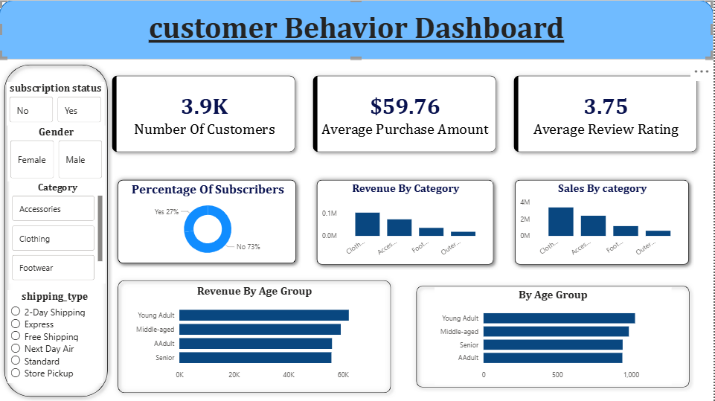
PART 03
POWER BI DASHBOARD
42.3
Interactive filters: Gender | Season | Shipping Type | Age Group | Subscription Status

Slide 15
PART 03
BUSINESS RECOMMENDATIONS
01
02
03
Boost Subscriptions
Loyalty Programs
Review Discount Policy
Promote exclusive benefits for subscribers to increase retention and drive recurring revenue
Reward repeat buyers to move them into the "Loyal" segment and increase lifetime value
Balance sales boosts with margin control on discount-dependent products to protect profitability
04
05
Product Positioning
Targeted Marketing
Highlight top-rated and best-selling products in marketing campaigns to maximize conversion rates
Focus marketing efforts on high-revenue age groups (18-35) and express-shipping users for optimal ROI

Slide 16
THANK YOU
Tech Stack & Conclusion
This project successfully transformed raw transactional retail data into actionable business insights using a complete analytics pipeline — from Python data cleaning and feature engineering, through SQL business analysis, to Power BI interactive visualization.
Key Achievements
● Cleaned and engineered 3,900 retail records
● Solved 10 business questions with advanced SQL
Tools & Technologies
● Built interactive Power BI dashboard
Python
Pandas
NumPy
MySQL
● Delivered 5 actionable business recommendations
SQL
Power BI
Jupyter
Questions?
End-to-End Data Analytics Project
Python · SQL · Power BI · 2025

